Slide 1
Welcome to the Union County Youth Forward Orientation Center For Youth Employment

Slide 2
ABOUT US
Youth Forward is a full service program designed to help both in and out of school youth reach their educational and employment goals. This comprehensive program achieves this by utilizing a comprehensive, collaborative approach to creating opportunities for youth. As a result, these youth can then acquire the necessary life skills, education, work exposure and experiences to enable them to have productive careers and become responsible family members and citizens. Youth Forward utilizes the WIOA 14 Elements in order to reach these goals.

Slide 3
Are you Eligible?
Eligibility Requirements
PROOF OF AGE/BIRTH DATE
SOCIAL SECURITY NUMBER
CITIZENSHIP/ALIEN STATUS
SELECTIVE SERVICE REGISTRATION *males over 18
PROOF OF FAMILY SIZE
INDIVIDUAL INCOME
FAMILY INCOME *If 18 ½ and younger without a disability
DOCUMENTATION TO SUPPORT BARRIER

Slide 4
In School Youth Requirements
In-School Youth (ISY) Ages 14-21
Youth attending school (as defined by State law), including secondary and post-secondary school, and not younger than age 14 or older than age 21 at time of enrollment. Because age eligibility is based on age at enrollment, participants may continue to receive services beyond the age of 21 once they are enrolled in the program.

Slide 5
ISY Eligibility Barriers
Basic skills deficient
An English language learner
An offender
Individual with disability
A homeless individual
A homeless child or youth
A runaway
An individual in foster care or who has aged out of the foster care system or who has attained 16 years of age and left foster care for kinship guardianship or adoption, a child eligible for assistance, who is in an out-of-home placement.
An individual who is pregnant or parenting.
An individual who requires additional assistance to enter or complete an educational program or to secure or hold employment.

Slide 6
Out of School Youth Requirements
Out-of-School Youth (OSY) Ages16-24
Youth not attending any school, Not younger than 16 or older than age 24 at time of enrollment. Because age eligibility is based on age at enrollment, participants may continue to receive services beyond the age of 24 once they are enrolled in the program

Slide 7
OSY Eligibility Barriers
A high school dropout;
A youth who is within the age of compulsory school attendance, but has not attended school for at least the most recent complete school year calendar quarter. School year calendar quarter is based on how a local school district defines its school year quarters. In cases where schools do not use quarters, local programs must use calendar year quarters;
A recipient of a secondary school diploma or its recognized equivalent who is a low income individual and is either basic skills deficient or an English language learner;
A homeless individual;
An individual in foster care or who has aged out of the foster care system, or who has attained 16 years of age and left foster care for kinship guardianship or adoption;
A child eligible for assistance, or in an out-of-home placement;
An individual who is pregnant or parenting;
An individual with a disability;
A low-income individual who requires additional assistance to enter or complete an educational program or to secure or hold employment

Slide 8
Upgrade Your Skills
Workforce Innovation Opportunity Act

Slide 9
WIOA 14 ELEMENTS
Comprehensive guidance and counseling
Education offered concurrently with, and in the area context as workforce preparation activities and training
Financial literacy education
Provision of labor market information
Activities that help youth prepare for and transition to post-secondary education and training
Entrepreneurial skills training
Tutoring, study skills, and dropout prevention
Alternative education
Paid and unpaid work experiences
Occupational skills training
Leadership development
Supportive services (Transportation, child care, work uniforms, tools, etc.)
Adult mentoring for 12 months
Follow-up services for 12 months

Slide 10
Youth Forward Intake Process
Orientation
Intake/Eligibility Determination ( Remote Appointments)
CASAS Testing ( Performed Remotely) Mandatory for all youth!
Develop an Individual Service Strategy Plan with a Youth Employments Specialist ( WIOA Elements) (Performed Remotely)

Slide 11
Youth Career Pathways
Where have you been?
Where are you now?
Where do you want to go?
Comprehensive Career Services:
1. Assessment of your skills, resume, job history.
2. Youth Employment Specialist will tailor a pathway to get you where you want to go.
Soft Skills
Workshops
Targeted job searches
On the job training
Job Fairs
Career Pathway

Slide 12
Selective Service for all Males
Exceptions
Born before January 1, 1960
Incarcerated with no release dates-between age 18-26
Mentally institutionalized with no release dates- between 18-26
Entered the US after the age of 26 and have passport or INS document with date of entry
Selective Service - www.sss.gov
847-688-6888 or 1-888-655-1825
9am-5pm
Have date of birth & social security # and name at the time of registration on hand

Slide 13
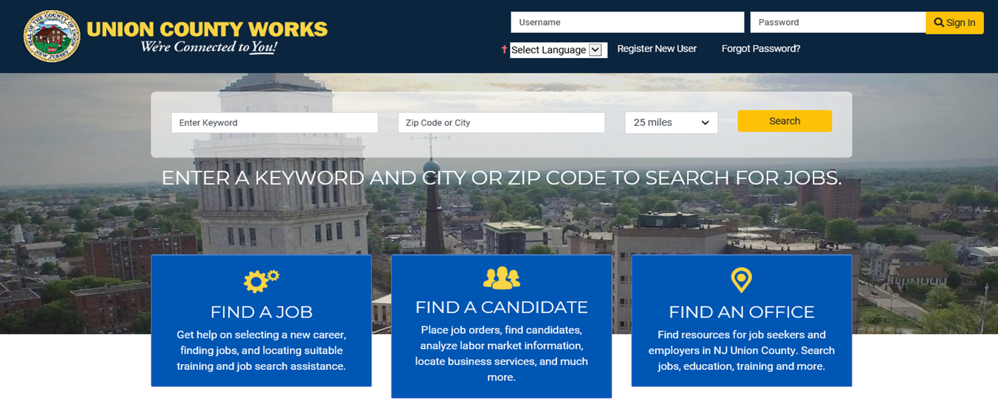
Jobseeker Website
Union County Works is an online virtual one stop that can be used to assist all job seekers find job openings, information on how to access education and training for new jobs, and create resumes.
Address: www.ucajc.org

Slide 14
Workforce Learning Link
Self Paced
Math - Adult Basic Education GED Prep
Basic Computer Skills Beginners Typing Course
ESL (English as a Second Language)
Learn at your own pace!
Using the computer, the Workforce Learning Link provides interactive training services that allow participants to learn at their own pace. The programs provide a wide range of self-paced learning opportunities in basic skills and ESL (English as a Second Language).

Slide 15
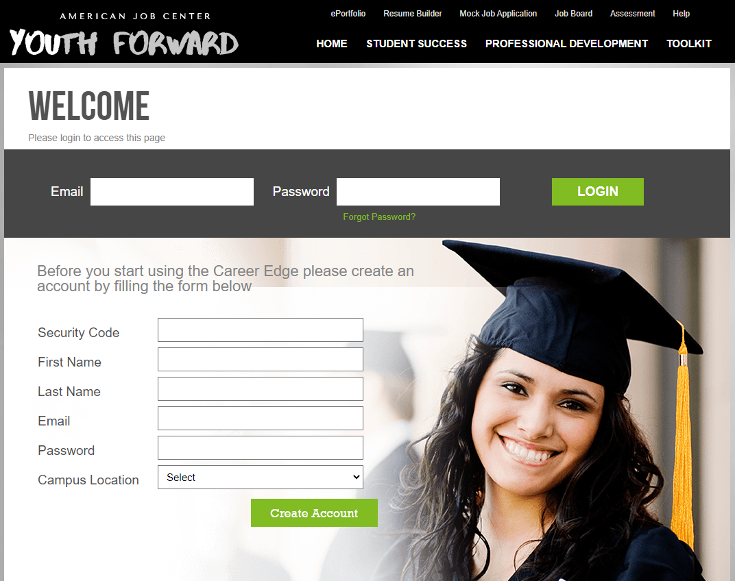
Youth Forward Career EDGE Online Professional Development Learning Portal
Career EDGE is designed to support you by connecting you with training content, resources and tools to take the first steps in your journey toward employment and career success.

Slide 16
Live Life Virtually App
Live Life Virtually “Your Practice Life” is an educational gaming platform that teaches life skills such as financial literacy, nutrition, wellness, time management and career readiness. Players make a series of choices throughout the game, which lead you to multiple outcomes and influence elements of your virtual life, such as happiness, health, wealth, and energy.

Slide 17
Financial Aid
Free application for Federal Student aid is the form that the student must complete to apply for federal and NJ State financial assistance including Stafford Loans
www.fafsa.ed.gov
Grants, scholarships, work- study and loans
www.nj.gov/nj/education/aid/

Slide 18
Union County College Workforce Innovation Business Center SOFT SKILLS TRAINING
The soft skills training course is a comprehensive eight day, 40-hour course developed in collaboration with the Union County Workforce Development Board. The course is designed to provide Union County residents entering the workforce with workplace foundation skills that apply across a wide range of job positions.
Course Goals:
The soft skills training course introduces students to a variety skill sets employers desire from job seekers. Students will gain applicable knowledge of:
• Interpersonal Skills/ Communications
• Workplace Readiness
• Teamwork
• Computer Basics
• Customer Service
• Problem Solving/Critical Thinking/Time Management
• Computer Training/Online Resources
• Job Search Basics/Job Search Essentials

Slide 19
Division of Youth Services www.ucnj.org/youth Union County ucnj.org New Jersey Department of Labor careerconnections.nj.gov New Jersey Division of Unemployment Insurance myunemployment.nj.gov New Jersey Covid-19 Information covid19.nj.gov
Important Websites

Slide 20
Important Websites
Department of Child Protection and Permanency (DCPP) For reporting allegations of abuse and neglect 1-877-NJ-ABUSE (1-877-652-2873)
The New Jersey Suicide Prevention HOPE LINE
1-855-654-6735
website http://www.njhopeline.com/
NJ LGBTQI Resources
https://www.nj.gov/dcf/adolescent/lgbtqi/

Slide 21
Contact US…
EMAIL or CALL US:
Youth Forward
Division Of Youth Services
(908) 558-2520
www.ucnj.org/youth
Karen M. Robinson, Youth Forward Administrator
(908) 558-2526
Email: krobinson@ucnj.org
Katerin FarIAS, Youth Forward Supervisor
Email: Katerin.Farias@ucnj.org
Tel: (908) 558-2524
Union County Works:
ucajc.org

Slide 22
Division of Youth Services – Elizabeth
1143 East Jersey Street. Elizabeth, New Jersey 07201
(908) 558-2520
American Job Center - Plainfield
200 West 2nd St. Plainfield, New Jersey 07060
(908) 757-9090
ON SITE LOCATIONS ARE CURRENTLY CLOSED TO THE PUBLIC

